Slide 1
Perioperative Care of the Adult Transgender Patient
Part 2 – Discrimination and Health Disparities

Slide 2
Discrimination
2006 Virginia Transgender Health Initiative Study | 2009 When Health Care Isn’t Caring | 2011 National Transgender Discrimination Survey | 2012 Project Implicit | 2015 Unites States Transgender Survey
Resource Center for Minority Data | Lambda Legal and Partner Organizations | National Center for Transgender Equality and the National Gay and Lesbian Task Force | Harvard University | National Center for Transgender Equality
Multiyear project to assess health care and social needs 350 self-identified transgender participants 41% reported experiencing discrimination and noted a greater degree of discrimination in health care facilities than in other settings | Nationwide survey 4,916 participants 26.7% had been refused health care 15.4% had health care providers refuse to touch them or use excessive precautions during examination 20.9% were talked to with harsh or abusive language 20.3% were blamed for their own health problems 7.8% received physically rough or abusive treatment | Nationwide study 6,450 participants 24% were denied equal treatment 25% experienced verbal harassment/ disrespect 2% experienced a physical attack | Determined that the intersectionality of racism, sexism, homophobia, and transphobia in social and medical systems leads to worse health outcomes for marginalized populations | Largest survey of transgender-identifying individuals in the United States 22% reported postponing care due to the fear of discrimination
Notes:
People have identified as transgender for centuries. This does not imply cultural acceptance. “Widespread discrimination and mistreatment threaten the health and wellness of transgender people, making them one of the most marginalized populations in medicine” (Tollinche et al., 2018, p.360).
Advocates have reported that legislators in numerous states introduced more than 300 pieces of anti-LGBTQ+ legislation in 2022 (Neira & Bowman, 2022).
It’s important for us as health care providers to recognize the potential for bias when caring for transgender patients and address it within ourselves so that we can provide appropriate care.
The Virginia Transgender Health Initiative Study was a multiyear project to assess the health care and social needs of the transgender population in Virginia. 350 self-identified transgender people completed a needs assessment. 41% reported experiencing discrimination and noted a greater degree of discrimination in health care facilities than any other setting.
In 2009, members of Lambda Legal and its partner organizations distributed a nationwide survey to lesbian, gay, bisexual, and transgender individuals. 4,916 respondents reported the following in health care settings:
26.7% reported being refused healthcare
15.4% reported that staff members refused to touch them or used excessive precautions during examination
20.9% reported that health care professionals used harsh or abusive language
20.3% reported that health care professionals blamed them for their own health problems
7.8% reported that health care professionals were physically rough or abusive
In 2011, members of the National Center for Transgender Equality and the National Gay and Lesbian Task Force conducted a nationwide study titled Injustice at Every Turn: A Report of the National Transgender Discrimination Survey. The researchers gathered online and written survey information from 6,450 transgender individuals. One section of the survey asked respondents to identify discrimination based on health care location, categorized as doctors’ offices, hospitals, and emergency departments. Types of discrimination were classified as denial of equal treatment, verbal harassment/disrespect, and physical attack.
Survey respondents identified discrimination occurring in doctors’ offices, hospitals, and emergency departments, including the following:
24% were denied equal treatment.
25% experienced verbal harassment/disrespect.
2% experienced a physical attack.
In 2012, Project Implicit determined that the intersectionality of racism, sexism, homophobia, and transphobia in social and medical systems leads to worse health outcomes for marginalized populations.
In 2015, the United States Transgender Survey (USTS)—the largest survey of transgender-identifying individuals in the United States—was administered by the National Center for Transgender Equality (NCTE). Analysis of the survey found that 22% of respondents reported postponing care due to fear of discrimination.

Slide 3

Health Disparities
High rates when compared with the heterosexual/cisgender population
  Reduced access to care
  Delaying health care due to fear
  Higher rates of depression, anxiety, and suicide
  Poorer health outcomes
  Lack of familial and other social support
  Higher rates of negative health behaviors
    Smoking
    Drinking
    Drug use
    Illicit silicone injections
    Unregulated hormone therapy
Notes:
Health disparities are population-specific differences in access to health care, quality, utilization of health care, and outcomes (Kachen & Pharr, 2020). Public health research found the LGBTQ+ population to have higher rates of disparities compared to the hetero/cis population (Kachen & Pharr, 2020). The US Department of Health and Human Services noted that these health disparities were linked to stigma, discrimination, and denial of civil and human rights (Neira & Bowman, 2022). There is also a lack of familial and other social support (Tollinche et al., 2018).
Patients may experience reduced access to care; may delay health care due to fear; and may have higher rates of negative health behaviors (smoking, drinking, drug use); higher rates of depression, anxiety, and suicide; and poorer health outcomes (Kachen & Pharr, 2020) (Collister, Saad, Christie, & Ahmed, 2012).
There is also a history of unregulated silicone injections and other treatments that could be harmful. Silicone injections are most often associated with liquid silicone being injected into the breasts, buttocks, thighs, and face to feminize appearance. The silicone can be cut with other substances, too — and it's impossible to know what someone is injecting each time. One 2013 study of illicit silicone injections in Brazil found that it sometimes also contained olive oil, paraffin wax, or even transmission fluid (Nett, 2019). Adverse outcomes include:
Infections
Granulomas
Pneumonitis
Organ failure
Chronic wounds
Disfigurement from migration
Chronic pain
Bone damage
When there are barriers to health care and prescribed hormones can be difficult to obtain, there are also hormones available on the black market. Unregulated, unmonitored hormone therapy can be unsafe (Tollinche et al., 2018).

Slide 4
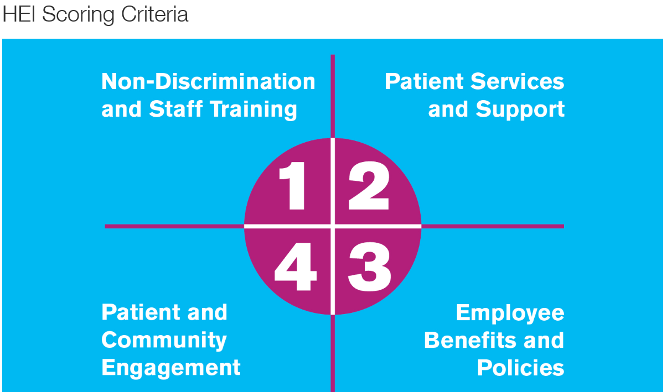
Advocacy
Discrimination prevents members of the community from accessing health care services
  Speak up
  Educate
  Support trans-inclusive change
Recognize your potential for bias
Create a safe and welcoming environment
  Reassure patients’ privacy
Human Rights Campaign Healthcare Equality Index (HEI)
Notes:
Discrimination prevents members of the community from accessing health care (Kachen & Pharr, 2020). When you encounter it, speak up. Address it directly with the offender and, if this is not productive, utilize your chain of command.
Educate yourselves and use opportunities to educate others. There is an abundance of misinformation available to the public. This misinformation fuels intolerance and discrimination. Take what you learn and share it with those who don’t understand. Information spreads quickly, whether it’s true or not, so do your best to spread the correct information from a place of kindness and understanding. Take the opportunity to listen to and interact with members of the trans community. The more familiar you become with the community the easier it is to evaluate yourself and make changes.
Support trans-inclusive shifts in policy, practice, and health care institutions. Together we can break down barriers to health care, positively impact outcomes, and advance the medical community.
There are several trans advocacy groups that you can research and engage with. They also provide some great education.
Some Examples are:
Out Youth (https://www.outyouth.org/)
PFLAG (https://pflag.org/)
Recognize your own potential for bias. Bias is an unfair belief that something about a person or group is better or worse than another. For example, a person who supports gender norms may believe that they are superior to a transgender person who rejects these norms.
Feelings of superiority may prejudice a person and make it difficult to accept different points of view or behavior and result in unfair treatment of those who do not share the same convictions or beliefs. Although AORN and the American Nurses Association both state that nurses should provide nondiscriminatory care to all patients, this is not always what is provided.
It is our responsibility to create a safe and welcoming environment. Transgender patients can be very protective of their physical and emotional privacy, so they may be less likely to talk or share about themselves when they meet a new provider. Reassure the patient that as their perioperative team, you will make sure they are safe and will be protected throughout the procedure—just a few words of comfort and reassurance will go a long way.
The Human Right’s Campaign’s Corporate Equality Index is the national benchmarking tool on health care policies, practices, and benefits pertinent to lesbian, gay, bisexual, transgender, and queer patients and employees. HEI participants are given a score based on how many LGBTQ+ inclusive policies and practices they have in place in four different criteria. The first criteria consist of the foundational elements of LGBTQ+ patient-centered care. The three remaining criteria are Patient Services and Support, Employee Benefits and Policies, and Patient and Community Engagement. Participants that have earned the LGBTQ+ Healthcare Equality Leader designation have received the highest score in each criteria and have demonstrated that they offer transgender inclusive health care benefits to their employees. An impressive 496 (55%) of HEI 2022 participants met this standard and earned the LGBTQ+ Healthcare Equality Leader designation.

Slide 5
Barriers to Care
Refusal to treat
Fear of discrimination or negative past experiences with health care
Lack of affirming care
Lack of adequately trained providers
May need to travel to receive appropriate care
High medical costs or inadequate insurance coverage
Lack of privacy or fear of disclosure
Identification documents
  May not match
Changing gender on a medical insurance card may have unintended consequences
  Examples: denied coverage for prostate cancer or denied a pap smear as part of an annual exam
Notes:
What’s preventing transgender patients from receiving the care they need?
Nearly 60% of trans patients feel the need to educate their practitioners on trans health issues (Ross & Bell, 2017).
(Kachen & Pharr, 2020)
(Tollinche et al., 2018)

Slide 6
References for Part 2
Collister D, Saad N, Christie E, Ahmed S. Providing care for transgender persons with kidney disease: a narrative review. Can J Kidney Health Dis. 2021;8:2054358120985379. https://doi.org/10.1177/2054358120985379
Kachen A, Pharr JR. Health care access and utilization by transgender populations: a United States transgender survey study. Transgend Health. 2020;5(3):141-148. https://doi.org/10.1089/trgh.2020.0017
Neira PM, Bowman RC. Improving perioperative nursing care for transgender and gender-diverse patients. AORN J. 2022;116(5):404-415. https://doi.org/10.1002/aorn.13808
Nett D. For trans women, silicone ‘pumping’ can be a blessing and a curse. NPR: Code Switch. September 1, 2019. Accessed May 8, 2024. https://www.npr.org/sections/codeswitch/2019/09/01/755629721/for-trans-women-silicone-pumping-can-be-a-blessing-and-a-curse
Ross KA, Bell GC. A culture-centered approach to improving healthy trans-patient–practitioner communication: recommendations for practitioners communicating with trans individuals. Health Communication. 2017;32(6):730-740. https://doi.org/10.1080/10410236.2016.1172286
Tollinche LE, Walters CB, Radix A, et al. The perioperative care of the transgender patient. Anesth Analg. 2018;127(2):359-366. https://doi.org/10.1213/ANE.0000000000003371

