Slide 1
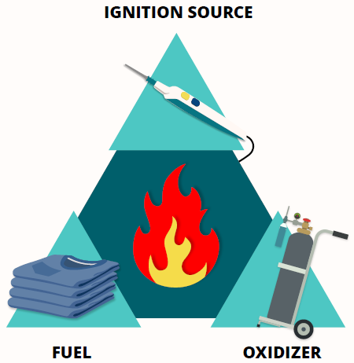
Fire Safety in the OR

Slide 2
Outcome
You will gain knowledge of interventions to prevent and manage fires in the OR and transfer this knowledge into clinical practice.
Objectives
Discuss concepts related to fire safety in the OR.
Describe key takeaways to prevent and manage fires in the OR.
Fire Safety

Slide 3

Surgical Fires
~90 to 100 per year in the United States
  95% are minor
  1-2 are fatal
Notes:
The estimates on this slide are based on the most recent data from ECRI. The estimate of 90 to 100 fires per year in the OR is down from the previous estimate of 200 to 240 per year, and although the number of reported events appears to be trending downward, reporting is not mandatory so there really isn’t any clear data regarding how many fires actually occur in the OR.
Of these fires, most of them are minor and result in no injury. However, 1 to 2 fires a year are fatal, and these are usually airway-related.
Surgical Fire Prevention. ECRI. Accessed December 8, 2023. https://www.ecri.org/solutions/accident-forensic-investigation-services/surgical-fire-prevention
Surgical Fire Data. ECRI. 2009. Updated 2017.

Slide 4
Surgical Fire Sites
44% head, neck, chest
26% on the patient
21% in the airway
8% in the patient
Fire Safety
Notes:
The anatomical sites where fires most frequently occur include the head, neck, or upper chest (44%), elsewhere on the patient (26%). Examples of fires on the patient include a fire on the drapes or the patient’s skin. It is also estimated that 21% of OR fires occur in the patient’s airway and 8% occur elsewhere in the body (eg, within a body cavity).
Surgical Fire Data. ECRI. 2009. Updated 2017.

Slide 5
Fire Triangle
Notes:
New for 2024, the fire triangle graphics have been updated.
In order for a fire to occur, the three components of the fire triangle must be present: a fuel, an oxidizer, and an ignition source. Although historically, responsibility for each of these three areas has been assigned to a member of the perioperative team, this latest iteration of the fire triangle removes those assignments to emphasize that fire prevention requires team collaboration, the idea being that everyone should intervene to prevent a fire.
Examples of fuels include alcohol-based skin antiseptics, surgical drapes, gowns, and even patients (eg, gastrointestinal gases, hair, adipose tissue). The most common fuel associated with surgical fires are surgical drapes, which contribute to 81% of surgical fires.
Ignition sources include electrosurgical devices, powered surgical instruments (eg, drills, burrs, saws), fiberoptic light cords, and lasers. The electrosurgical unit is the most frequently identified ignition source and is involved in about 70% of all surgical fires.
Oxidizers include oxygen and nitrous oxide, particularly when the concentration of oxygen is elevated enough to create an oxygen-enriched environment.

Slide 6
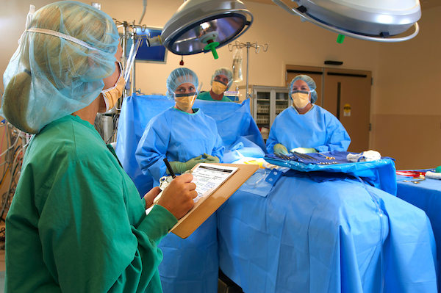
Fire Prevention Starts with Assessment of Risk
3.2
“As part of the preprocedural briefing process, the perioperative team should initiate a fire risk assessment to assess for the presence of the three elements of the fire triangle.”
[Recommendation]
Fire Safety
Notes:
Fire prevention starts with assessment of risk and this task is no longer the sole responsibility of the RN circulator. Based on review of the evidence, it is clear that the whole perioperative team is responsible for fire prevention, so the wording of the recommendation now reflects this shared responsibility. Recommendation 3.2 of the Guideline for a Safe Environment of Care now reads, “As part of the preprocedural briefing process, the perioperative team should initiate a fire risk assessment to assess for the presence of the three elements of the fire triangle.”

Slide 7
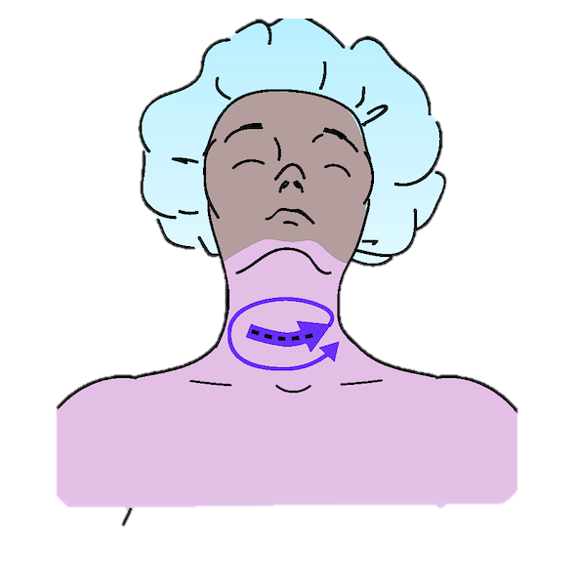
High-Potential Procedures
Surgical procedures performed above the xiphoid process and in the oropharynx carry the greatest risk:
  Lesion removal on the head, neck, or face
  Tonsillectomy
  Tracheostomy
  Burr hole surgery
  Removal of laryngeal papillomas
Fire Safety
Notes:
There are certain procedures which have a higher potential for a fire to occur because of the presence of an oxygen-enriched environment and the proximity of the surgical site to the ignition source. These include procedures above the xiphoid process, those on the head, neck, face, or upper chest.

Slide 8
Fire Risk Assessment Process
Before the procedure starts
Everyone participates
Identify fire risks that are present
Intervene based on the risks identified
Document assessment and that action was taken
Fire Safety
Notes:
Including the fire risk assessment as part of the pre-procedural briefing enables the team to intervene to prevent a fire from occurring. All team members should participate in the fire risk assessment process.
Document the fire risk assessment and that action was taken to address the identified risks. This documentation will facilitate quality improvement, and, if a fire does occur, documentation can provide information and support the actions that were taken during the fire.

Slide 9
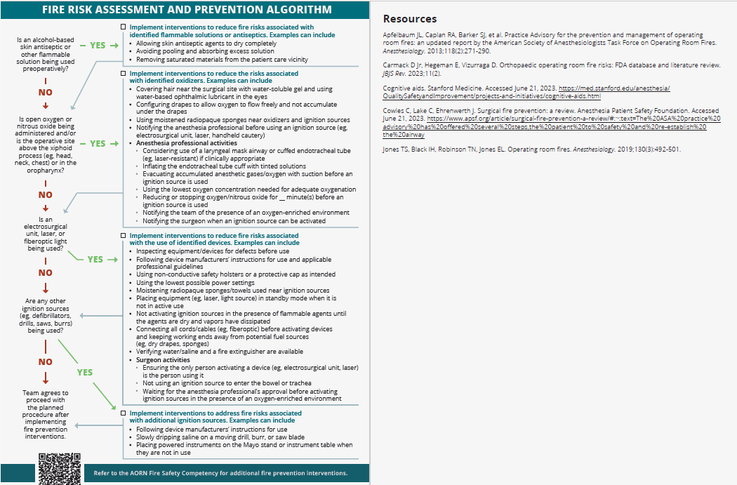
3.2.1, 3.2.2
THERE IS NO FIRE RISK CATEGORY OR SCORE!
Notes:
Much of the evidence on fire safety supports the use of cognitive aids as part of the fire risk assessment process, so AORN merged what used to be the fire prevention assessment tool and fire prevention assessment protocol into an easy-to-use algorithm that has a resource list on the back side.
The new Fire Risk Assessment and Prevention Algorithm is designed to help the perioperative team identify fire risks and then direct appropriate intervention depending on the risks that are present. It asks four yes/no questions about the presence of the three components of the fire triangle - fuels, ignition sources, and oxidizers – and then provides examples of interventions that can be applied to the specific risks.
Users will notice that the process does not produce a score or categorize risk as low, moderate, or high – and this is by design because a fire risk score or category doesn’t clearly indicate which of the fire triangle components are present, nor does it provide a direct course of preventive action. Fire prevention interventions should address the specific risks identified by the team during the fire risk assessment. The Fire Risk Assessment and Prevention Algorithm directs users to intervene according to the fire risks that are present.
A long list of interventions will be covered in the next few slides, but only those that are identified as applicable during the assessment need to be performed.

Slide 10

Ignition Sources
Electrosurgical unit (ESU)
Argon beam coagulator
Power tools (eg, drills, burrs, saws)
Fiberoptic light cords
Lasers
Notes:
Let’s take a more detailed look at ignition sources. Here are some examples of potential ignition sources commonly found in the perioperative setting.
An ignition source is defined as anything that provides enough energy to start a fire. This energy may be in the form of a visible spark, or it could just be heat at a temperature high enough to cause a fire to ignite. Remember, a spark is not always necessary to start a fire. The ESU is the most frequent ignition source, being involved in approximately 70% of OR fires, while 20% of fires involve other heat sources, such as hand-held battery-operated devices, fiberoptic light sources, or defibrillators, and 10% of fires involve lasers.

Slide 11
Reducing Risks: Ignition Sources
Follow device manufacturer’s IFU
Inspect equipment/devices before use
Use safety holsters or protective caps as intended
Use lowest possible energy settings
Communicate with team before activating devices
Moisten soft goods used near ignition sources
Place equipment in standby mode
Verify availability of water/saline and extinguisher
Fire Safety
Notes:
These are some examples of interventions that can be implemented to reduce risks associated with ignition sources. Only interventions that are identified as applicable during the fire risk assessment need to be implemented.
Follow the device manufacturer’s instructions for use and use accessory devices (eg, safety holsters, protective caps) as intended because safety features have been tested and verified under certain conditions of use. Avoid using packaging materials or red rubber catheters as protective covers or insulators because they are not designed or intended for those purposes and could melt or catch fire during use.
Carefully inspect equipment and devices before use and remove from service any items found to be defective (eg, frayed cords, impaired insulation).
Storing the ESU pencil or other energy device in a non-conductive safety holster when not in use reduces the chance of accidental activation and separates the ignition source from fuel.
Moistening drapes, towels, and sponges used in close proximity to an ignition source is recommended. This action increases the temperature needed for these items to ignite, reducing the risk of fire.
Place light sources in standby mode when not in active use. The working ends of fiberoptic light cords generate a lot of heat and can cause burns or ignite items if allowed to rest on draped surfaces.
Place laser units in standby mode when not in active use to prevent inadvertent activation.
[Note to presenter: A more comprehensive list of interventions, including interventions specific to the use of lasers, can be found in the AORN Fire Safety Competency Tool.]

Slide 12
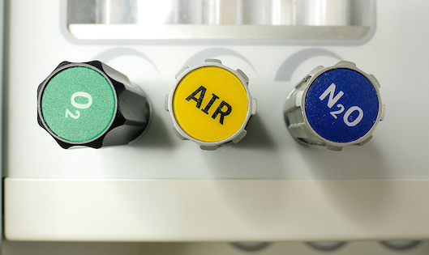
Oxidizers
Notes:
The next side of the fire triangle is the oxidizers that are present in every perioperative setting. Oxidizers are defined as gases that can support combustion. This includes the ambient air that we breathe every day.
Oxygen by itself is not flammable, but as the concentration of oxygen increases, the temperature required for ignition decreases. Some fuel sources can ignite at a lower temperature than if it were in the presence of ambient or medical air where there would be a lower concentration of oxygen.
An environment is considered oxygen- or oxygen-enriched when the oxygen concentration is greater than 21% by volume. This is a little more conservative than the definition adopted by the National Fire Protection Association, which quantifies an oxygen-enriched atmosphere as having a 23.5% oxygen concentration by volume. The reason this is important is that some items will not burn in ambient air but they will burn when the oxygen concentration is elevated.
75% of OR fires occur in an oxygen-enriched atmosphere.
An oxygen-enriched environment is easily created when oxygen is administered to the patient at greater than 30% via an open delivery system and in a confined area, such as under drapes that are close to the patient’s face.
Nitrous oxide (N₂O) is also considered an oxidizer and requires the same precautions as oxygen.

Slide 13
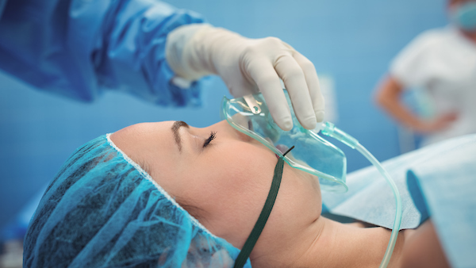
Reducing Risks: Oxidizers
Verify anesthesia circuit and gas connections are leak-free
Configure drapes to prevent accumulation of oxygen
Use moistened sponges
Minimize use of ignition sources when possible
Communicate the presence of an oxygen-enriched environment
Communicate with the team before activating devices
Anesthesia professional activities
  Intubate or use laryngeal mask airway if clinically indicated
  Use tinted solution in the endotracheal tube cuff
  Reduce oxygen delivery to minimum needed and stop nitrous oxide
  Flush with medical or ambient air
  Notify the surgeon when an ignition source can be activated
Fire Safety
Notes:
Here are some examples of interventions that can be implemented to reduce risks associated with oxidizers.
Configure surgical drapes placed near the patient’s head to prevent accumulation of oxygen and allow sufficient venting.
Use moistened sponges when oxidizers and ignition sources are used in proximity to each other, especially head, airway, or neck procedures.
Minimize the use of ignition sources (eg, use scalpel instead) during procedures on anatomical structures that present special fire hazards (eg, bowel, trachea).
Notify the team when there is an oxygen-enriched environment and before activation ignition sources.
Collaborate with the anesthesia professional.
There is some conflict in the literature as to the length of time to wait after stopping oxygen delivery before activating an ignition source. Recommendations range from one minute to a “few” minutes (eg, 1 to 3 minutes). It is [facility name]’s policy to reduce or stop oxygen/nitrous oxide for ___ minutes before using an ignition source.
[Note to presenter: A more comprehensive list of interventions can be found in the AORN Fire Safety Competency Tool.]

Slide 14

Fuels
Patient
Linens
Sponges
Dressings
Surgical drapes
Surgical attire
Bone cement
Alcohol-based skin antiseptic
Endotracheal tubes
Fire Safety
Notes:
Here is a list of some common fuels found in the perioperative setting. A fuel is defined as anything that will burn. Fuel sources are present in every surgical procedure and can include alcohol-based skin antiseptics, soft goods (eg, radiopaque sponges), bone cement, endotracheal tubes, dressings, linens (eg, gowns, sheets, blankets), surgical drapes, and more. Patients can also serve as fuel because gastrointestinal gases, hair, and adipose tissue are flammable. Some of these items, like alcohol-based skin antiseptics, give off fumes that are very flammable. When trapped under surgical drapes, these fumes greatly increase the risk of fire.
Many of these items will burn in ambient air, but if an oxygen-enriched environment is present, they will all burn and will burn faster than in the normal atmosphere. In addition, in the OR, we frequently see a combination of these fuel sources, which decreases the amount of energy (ignition source) required to start a fire. For example, an alcohol-soaked towel will ignite faster than a dry towel. Alcohol-based skin antiseptics are identified as the fuel in about 4% of surgical fires.
It is important to note that at the present time there are no regulations establishing standards for surgical drape flammability. A few drapes currently available in the US may have some degree of resistance to ignition in ambient air, but they will all burn in an oxygen-enriched environment and none are treated with flame-retardant chemicals. Drapes are the most common fuel source and associated with 81% of OR fires.
Culp Jr. WC, Kimbrough BA, Luna S. Flammability of surgical drapes and materials in varying concentrations of oxygen. Anesthesiology. 2013;119(4):770-776.
Surgical Fires. ECRI. 2016. https://www.ecri.org/components/HRC/Pages/SafSec13_1.aspx

Slide 15
Reducing Risks: Fuels
Implement
Implement safe practices when using alcohol-based skin antiseptics
Cover
Cover hair with water-soluble gel to cover hair
Use
Use water-based ophthalmic ointment in the eyes
Moisten
Moisten soft goods used near the surgical site
Fire Safety
Notes:
These are some examples of interventions that can be implemented to reduce risks associated with fuel sources. Only interventions that are identified as applicable during the fire risk assessment need to be implemented.
We’ll go into more detail on safe practices for alcohol-based skin antiseptics shortly.
During head or neck procedures, use water-soluble gel to cover the patient’s hair and water-based ophthalmic lubricant in the eyes.
Moistening drapes, towels, and sponges used in close proximity to an ignition source and oxidizer is recommended. This action increases the temperature needed for these items to ignite, reducing the risk of fire.
[Note to presenter: A more comprehensive list of interventions, including interventions specific to the use of lasers, can be found in the AORN Fire Safety Competency Tool.]

Slide 16
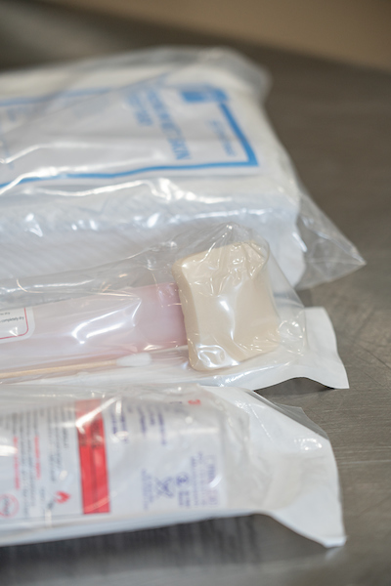
Alcohol-based Skin Antiseptics
3.4.2, 3.4.3
Prevent pooling by
  placing sterile or clean towels near the surgical preparation site to absorb drips and excess solution,
  using sterile towels to absorb excess solution from the prepped skin surface or for drying if indicated,
  removing materials that become wet with the skin antiseptic agent before draping the patient, and
  moving solution-soaked materials away from ignition sources and outside of the patient care vicinity (ie, 6 ft away)
Follow the skin antiseptic manufacturer’s IFU for recommended minimum dry time and allow the agent to dry completely before draping
Notes:
The recent guideline revision clarified the language used to describe sterile vs. clean towels used to prevent the pooling of alcohol-based skin antiseptics and added the term “patient care vicinity” to align with the language used in the updated National Fire Protection Association NFPA code. The patient care vicinity is defined as the space extending 6 feet beyond the normal location of the OR bed.
When using alcohol-based skin antiseptics, always avoid pooling on or near the patient and ensure the product’s minimum dry time has been observed and that the product is allowed to completely dry before draping the patient – even if this exceeds the manufacturer’s recommended minimum dry time.

Slide 17
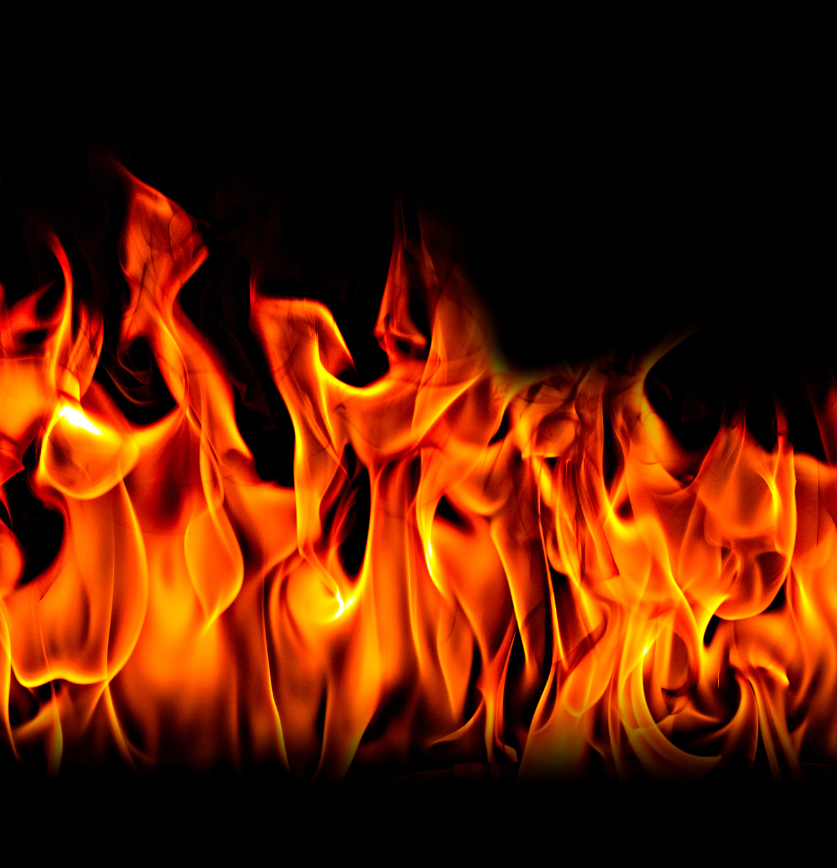
Managing Fires
Airway vs. non-airway
Patient vs. non-patient (eg, equipment)
In vs. on the patient
Fire Safety
Notes:
Even when all appropriate preventive measures have been taken, a fire can still occur. Therefore, perioperative teams should know how to fight a fire.
There are three different types of fires.
A fire on the patient is one that is superficial – on the surface of the skin, on the drapes, or involving the patient’s hair.
A fire in the patient is one that occurs within a body cavity. Examples include a fire in the airway involving an endotracheal tube or a fire involving the intestinal tract because gases within the bowel were ignited when the surgeon opened the bowel using an electrosurgical device.
The third type of fire involves equipment; this type usually does not directly involve the patient.

Slide 18
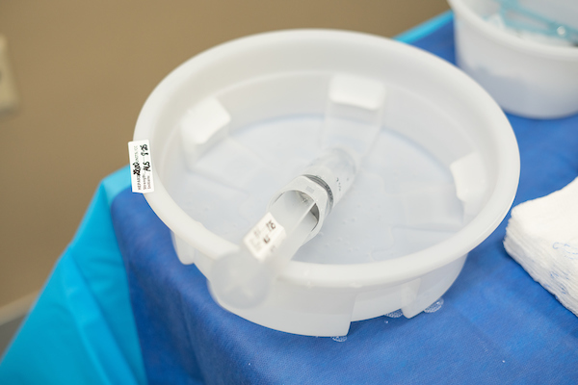
Using a Solution to Extinguish a Fire
Use a nonflammable liquid such as saline or water.
Aim at the base of the fire.
Remember: drapes may be impermeable.
Fire Safety
Notes:
One way to extinguish a fire is to pour a nonflammable liquid on it. When extinguishing a fire using a solution, aim the liquid at the base of the fire and be sure to cover it completely. Remember, many drapes are waterproof, and if the fire is burning under the drapes, pouring water on the drapes will have no not extinguish the fire. Impermeable drapes should be removed from the patient to effectively extinguish the fire.

Slide 19
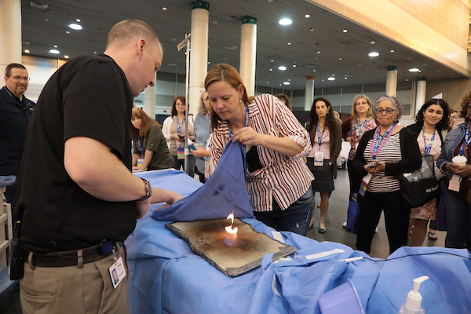
How to Smother a Fire
Hold towel between the fire and the patient’s airway.
Drop the end of the towel closest to the patient’s head.
Drop the other end of the towel over the fire.
Sweep hand over the towel from the patient’s head toward their feet.
DO NOT PAT.
Raise the towel.
Keep your body away from the fire.
Fire Safety
Notes:
In addition to or instead of extinguishing a fire using a solution, a fire can be smothered using a towel or similar item. Drop the end of the towel between the fire and the patient’s airway, keeping the towel between you and the fire. Lean into the patient and place your arm at the dropped end of the towel. Drop the other end of the towel over the fire. Sweep with your free hand over the towel to extinguish the fire. Do not pat the fire because this will fan the flames, and it will continue to grow.
When the fire is extinguished, raise the towel to decrease the heat. For your safety, keep your body, especially your face, as far away from the fire as possible.

Slide 20


Do not use fire blankets in the OR!
Fire Safety
Notes:
Fire blankets, which are intended to smother a fire, are not recommended for patient fires in the OR because they can trap the fire next to and under the patient, which may cause further injury. Use of fire blankets can also displace instruments when they are applied, contaminate the wound, and cause the fire to spread. Additionally, fire blankets are often made of wool and can burn in an oxygen-enriched environment.

Slide 21
NFPA* Fire Classification
Class A: wood, paper, cloth, and most plastics (eg, combustible materials)
Class B: flammable liquids or grease
Class C: energized electrical equipment
Combination: ABC, AC
* NFPA = National Fire Protection Association
Fire Safety
Notes:
The National Fire Protection Association (NFPA) classifies fires based on fuel source. This classification serves as the basis for fire extinguisher classification. The letters A, B, C, or a combination of these letters is found on fire extinguishers, and this corresponds to the type of fire it is effective against.
A Class A fire extinguisher is for a fire that has wood, paper, or cloth as the fuel. The Class This type of extinguisher can be filled with water under pressure and works by reducing heat, which addresses the ignition element of the fire triangle.
A carbon dioxide extinguisher works by removing the oxygen required for the item to burn and eliminates heat with a very cold discharge. Carbon dioxide extinguishers are rated for Class B and C fires but will also extinguish a Class A fire.
A dry chemical or a clean agent extinguisher can be rated for A, B, and C type fires. These extinguishers work by interrupting the chemical reaction of the fire triangle. Water-mist extinguishers can be rated for Class A and C fires.
There are additional classifications of fire but they do not apply to fires in the perioperative setting.

Slide 22
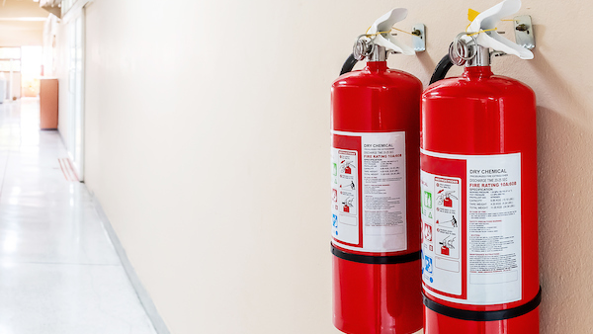
Fire Extinguisher Selection
Select according to the local authority having jurisdiction
Conflicting guidance
  NFPA recommends water mist or carbon dioxide
  ECRI recommends only carbon dioxide
[Facility-specific] extinguishers are available in the ORs at [facility name].
Fire Safety
Notes:
Select fire extinguishers according to the authority having jurisdiction (eg, fire marshal).
Factors that assist in determining the correct type of fire extinguisher to use include the
presence of electrical equipment,
presence of hazards or chemicals that could adversely react with the extinguishing agent,
maintenance requirements,
fire size,
ease of use, and
type of fuels present (ie, fire classification).
[Note to presenter: Insert the type of fire extinguisher available at your facility and explain why.]

Slide 23
Using a Fire Extinguisher
Remember “PASS”
P Pull the pin.
A Aim the nozzle at the base of the fire.
S Squeeze the handle.
S Sweep the stream over the base of the fire.
Notes:
If it is necessary to use a fire extinguisher, the first step is to obtain it from its storage location. (Note to presenter: Insert the location at your facility). When you are picking up the extinguisher, be aware that it may be heavy. Many extinguishers weigh about 20 pounds.
The extinguisher will have a handle that is locked by a pin. Take the handle of the extinguisher in one hand and pull the pin with the free hand. Do not compress the handle because this will result in the agent being dispersed from the nozzle. Drop the pin and, using your free hand, grab the hose and aim the end of the nozzle at the base of the fire. Do not continue to grab the nozzle because it may become very cold. Stand approximately 8 to 10 feet from the base of the fire. Squeeze the handle to release the agent and sweep back and forth to “chase the fire away.”
As the fire diminishes, move forward until the fire is extinguished or the extinguisher is empty. If the fire is not extinguished, evacuate the premises. Remember, fire extinguishers should not be your first line of defense. They are effective for extinguishing small fires.

Slide 24
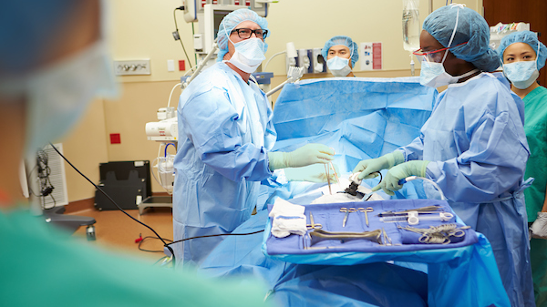
Fire Prevention and Management is a Team Effort
Perioperative RNs
Surgical technologists
Surgeons
Anesthesia professionals
Assistants
Environmental Services
Quality/Risk Personnel
Administrators
Fire Safety
Notes:
Fire prevention is truly a team effort and the role that you will play in prevention is dependent upon your job description.

Slide 25

Team Responsibilities in a Fire
Depends on:
  Personnel present
    Facility
    Time of day
  Size of the fire
  Location of the fire
Fire Safety
Notes:
Who is responsible for the tasks that must be rapidly accomplished in the event of a fire? This will vary depending on the type and size of the facility, the time of day, the number of people present, and the size and location of the fire. An example of a variance may be the difference between a hospital that has a staff of 25 people in the OR and an ambulatory surgery center that has a staff of 5 people.
Because of these variances, all personnel should be aware of all actions that should be taken in managing a fire.
[Note to presenter: Use the “Perioperative Team Member Roles During a Fire” document in the AORN Fire Safety Tool Kit to assign roles.]

Slide 26

Personnel
RN circulator
Scrub person
Anesthesia professional
Surgeon
Assistants
Supervising physicians
Charge RN
Support personnel
Administrator
Fire Safety
Notes:
All of the people filling these positions may be present in the perioperative suite at the time of a fire, but many of them are not present 24 hours a day or seven days a week. At a minimum, there will likely be a surgeon, an RN circulator, a scrub person, and an anesthesia professional. The responsibilities of each person will change depending on how many people are present.
Assistants can include RNFAs, anesthesia assistants, surgical assistants, and medical residents or students who are assisting in surgery.
Supervising physicians can include attending physician surgeons and supervising anesthesia professionals.
[Note to presenter: Add/delete positions based on your facility]

Slide 27
Surgical Fire Locations
Ambulatory surgery centers
Hospitals
Physicians’ offices
Fire Safety
Notes:
Fires can occur in any location where the three components of the fire triangle—a fuel, an oxidizer, and an ignition source—come together, so wherever surgeries are performed. This includes ambulatory surgery centers and surgical specialty hospitals, small community hospitals, larger academic medical or trauma centers, and even physicians’ offices where surgical procedures are performed.
The size of the facility may determine not only how many people are present at any given time but may also contribute to the familiarity of the fire department personnel with the location of perioperative services. In a large academic training facility, that has operating rooms in multiple buildings and on multiple floors, it may be challenging for fire department personnel to determine where the fire is located. In contrast, in a small rural facility, fire department personnel may be very familiar with the layout of the building because they have been there for other events, such as inspections.
A large ambulatory facility may have more personnel present than a small hospital or a larger facility on an off-shift. Every facility is different, and it is not safe to assume that the same types of facilities are similar.

Slide 28

Time of Day
Normal business hours
Evenings
Weekends
On-call hours
Fire Safety
Notes:
When a fire occurs, that is, the time of day and day of the week, affects the number of people present in the facility and the amount of traffic that fire department personnel may encounter while traveling to the facility.
[Note to presenter: Insert your plan for notifying the fire department, especially making note if it varies based on the time of day.]

Slide 29
Fire Size and Location
Small vs. large
Airway vs. non-airway
Patient vs. non-patient (eg, equipment)
Fire Safety
Notes:
The size and location of a fire can also influence the responsibilities of the team members. If the fire is small, the surgeon may smother the fire with a gloved hand or surgical towel or the scrub person may extinguish it using a solution like water or saline. During this type of fire, the RN circulator will not be involved in extinguishing the fire, but they may have other tasks to perform.
[Note to presenter: Insert your facility roles for the RN circulator when not involved in extinguishing the fire.]
If the fire is larger or is spreading fast, the surgeon may remove the burning drapes from the patient, throwing them onto the floor where the RN circulator takes over extinguishing the fire with a solution or a fire extinguisher, depending on how large the fire is and what firefighting method will be the fastest and most effective.

Slide 30
Responsibilities: All Fires
Alert team members to the fire
Stop the flow of airway gases
Smother or extinguish the fire
Push the instrument table away
Remove burning material
Assess for secondary fires
Assess the patient for injuries
Notify appropriate personnel
Act as a liaison to patient’s family
Retain involved materials and supplies
Document the event
Notify the fire department
Fire Safety
Notes:
These tasks or assignments are intended to serve only as examples and to raise awareness of what needs to be done if a surgical fire occurs. The actions listed here apply to all fire, but who is assigned to carry them out will vary based on the people present when the fire breaks out. Many of these tasks will occur simultaneously, so the order of when the events should occur is not implied in this listing, except for notification of the team, which should occur first.
In this presentation, the responsibilities listed will be linked to one of the four team members who are always present: RN circulator, surgeon, scrub person, and anesthesia professional. The person listed is the primary person to complete the responsibility, but that person may receive assistance from others, because fighting a fire is a team effort. Many of these tasks fall to the RN circulator or other unscrubbed personnel because they are not working within the sterile field.
Actions and the team members to take the action are:
Alert team members to the presence of a fire: whoever sees it first.
Stop the flow of airway gases to the patient: anesthesia professional.
Smother or extinguish the fire using an appropriate method (eg, aqueous solution, towel, gloved hand, fire extinguisher): surgeon or scrub person, if the fire is on the patient. RN circulator, if the fire or burning materials are not on the patient.
Push the instrument table away from the sterile field: scrub person. This step is intended to preserve the sterility of the instrument table.
Remove burning material from the patient: surgeon or scrub person.
Assess for secondary fire on underlying drapes or towels: surgeon or scrub person.
Assess the patient for injuries: surgeon or RN circulator.
Notify appropriate personnel—next in chain of command and fire department: RN circulator.
Act as a liaison to the families: surgeon, RN circulator, or designee (eg, risk management personnel, administrator) as determined by facility policy.
Sequester and retain involved material/supplies: RN circulator in collaboration with quality or risk management personnel.
Document the event: The entire team should assist in completing the event report after the patient is out of the OR. In many facilities the RN circulator completes this task.
[Note to presenter: Make changes as applicable to your facility.]

Slide 31
Responsibilities: Large Patient Fire
Activate the fire alarm system
Shut off the oxygen supply to the room
Smother or extinguish burning materials
Notify appropriate personnel
Delegate roles for non-direct caregivers
Direct traffic
Fire Safety
Notes:
These responsibilities must be individualized to each fire and are for the patient fire that is rapidly spreading or larger. Other team members, including ancillary personnel, may be involved depending on facility policy. These actions will be accomplished simultaneously and are in addition to the responsibilities for all fires on the previous slide.
The RN circulator should activate the alarm system or instruct a team member to do this. [Note to presenter: Insert correct method for your facility.]
Shutting off the oxygen supply to the room can be done by the [facility-specific person] but only after collaboration with the anesthesia professional. This will prevent oxygen from flowing into the atmosphere and contributing to an oxygen-enriched environment. This is not a first-line task but should be considered if the fire is growing.
The [facility-specific person] should extinguish any burning material that has been removed from the patient/sterile field using an appropriate method (eg, aqueous solution, towel, fire extinguisher). The surgeon, anesthesia professional, and scrub person may or may not be able to assist with this task.
Communicating with personnel in surrounding areas regarding the presence of a fire and to bring assistance is another task that may be accomplished by the RN circulator or delegated to other personnel.
If available, the charge RN or [facility-specific supervisory personnel] can delegate responsibilities to non-direct caregivers. If other personnel come directly into the OR where the fire is active, the RN circulator can also direct personnel.
The RN circulator or [facility-specific supervisory personnel] should direct traffic or delegate this task. Others in the facility may be assigned to this responsibility, such as a charge RN or a secretary. The assigned traffic director assists the fire response team or fire department to the fire location.

Slide 32
Responsibilities: Airway Fire
Remove the endotracheal tube from the airway
Disconnect and remove the breathing circuit
Pour saline into the airway
Examine the airway
Re-establish the airway and resume ventilation
Remove any burning materials from the airway
Fire Safety
Notes:
These actions will be performed simultaneously and are in addition to the responsibilities for all fires.
In a fire involving the airway or an endotracheal tube, the anesthesia professional directs care of the patient. The majority of actions listed are performed by the anesthesia professional or under their direction. This is a situation in which clear communication is absolutely essential; without it, the degree of injury to the patient may increase.

Slide 33
Responsibilities: Equipment Fire
Disconnect equipment from power source
Remove the working end of the equipment from the sterile field
Shut off the electricity to the equipment if unable to disconnect from outlet
Shut off gases to the equipment, if applicable
Remove equipment from the OR, if possible
Evacuate OR if necessary
Fire Safety
Notes:
Although rare, equipment fires, do occur, and being prepared for this scenario can help reduce the risk of injury to patients and personnel. These actions that are specific to fires involving equipment will fall primarily to the RN circulator and other personnel who are not at the sterile field. The first step is announcing the presence of fire to the team members and then disconnecting the equipment from the electrical outlet, if this can be accomplished safely. By completing this action, the ignition source is removed and the fire may be extinguished at this point. The remaining responsibilities can be carried out as required, including the responsibilities associated with all fires.

Slide 34
Responsibilities: OR Evacuation
Assist with the decision to evacuate
Order evacuation of the OR
Communicate the need to evacuate
Compile a list of people in the perioperative area
Activate the disaster plan
Order evacuation of the surrounding area
Fire Safety
Notes:
These responsibilities are necessary only if evacuation is required. ECRI indicates that evacuation is rarely required for fires originating in an OR, but teams should be aware of what to do if evacuation becomes necessary.
Assist with the decision to evacuate and orders evacuation of the room: The team collaborates to discuss and decide if evacuation is necessary and can involve the charge RN or a designated decision-maker and the fire department in making this decision.
A facility-designated person not directly involved in the procedure or room in which the fire originated should assume these responsibilities:
Communicate the need to evacuate to personnel in surrounding areas
Orders the evacuation of the perioperative areas
Compiles a list of all people in the perioperative area
Activates the disaster plan

Slide 35
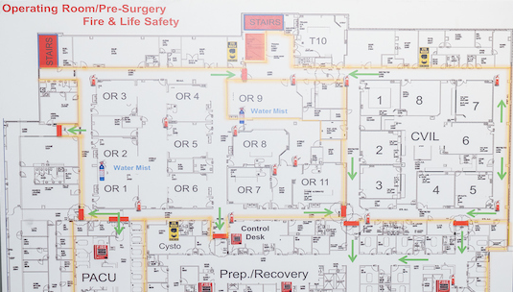
Evacuation Types and Areas
Horizontal or vertical evacuation
Fire doors
Smoke compartments
Evacuation floor plan maps
Fire Safety
Notes:
If evacuation is necessary, it can be accomplished by moving on the same floor (ie, horizontally) until you are behind a set of fire doors. Possible routes and the location of fire doors must be on display within the perioperative area according to local fire regulations and these are located [facility-specific map locations]. It is important to note that not all double-closing doors are necessarily fire doors, and this will be indicated on the evacuation route maps and on the doors themselves. A fire door can be identified as such by looking at the edge of the door for a label stating “fire door.”
A vertical evacuation, which is occasionally necessary, means moving from one floor to a safe location on a different floor. Vertical evacuation can be up or down depending on the location of the fire and the building construction.
The goal of evacuation is to move yourself and the patient to a safe point outside of the smoke compartment. A smoke compartment is created when the walls go from the floor to the ceiling with no open penetrations in them. Pipes may go through the wall, but they must be sealed so that no smoke can follow the pathway through that wall. The wall must extend to the real ceiling and not just up to a false ceiling. The facility engineering department can usually show you the smoke compartment and provide you with a map of your unit with the designated fire walls and/or smoke compartments defined.

Slide 36
Evacuation Procedure: Remember to “RACE”
R Rescue
A Alarm/Alert
C Confine/Contain
E Evacuate
Fire Safety
Notes:
An easy way to remember the steps for evacuation is to use the acronym RACE. These steps should be completed in sequential order. During an OR fire, the first step, Rescue, should be to move the patient out of the room where the fire is burning. The patient may need to be transported on the OR bed. Staff members should not place themselves at risk, but the decision to remain with the patient under dangerous conditions is a personal decision made in the moment.
Then sound the Alarm at the pull station, usually located in the hallway. Sounding the alarm will Alert any other rooms in the OR suite that there is a fire in the OR.
Next, Confine or Contain the fire; this means closing the door when you leave the OR and any other doors that may be open. When the fire alarm is activated, all fire doors should automatically close. This is why it is important that fire doors remain unobstructed by equipment.
The E stands for Evacuation of the entire OR suite, not to be confused with evacuation of the room where the fire is burning; that type of evacuation was completed in the Rescue step.
The steps of RACE are carried out if the decision has been made that you are unable to extinguish the fire, therefore, extinguish is not part of the RACE acronym.

Slide 37
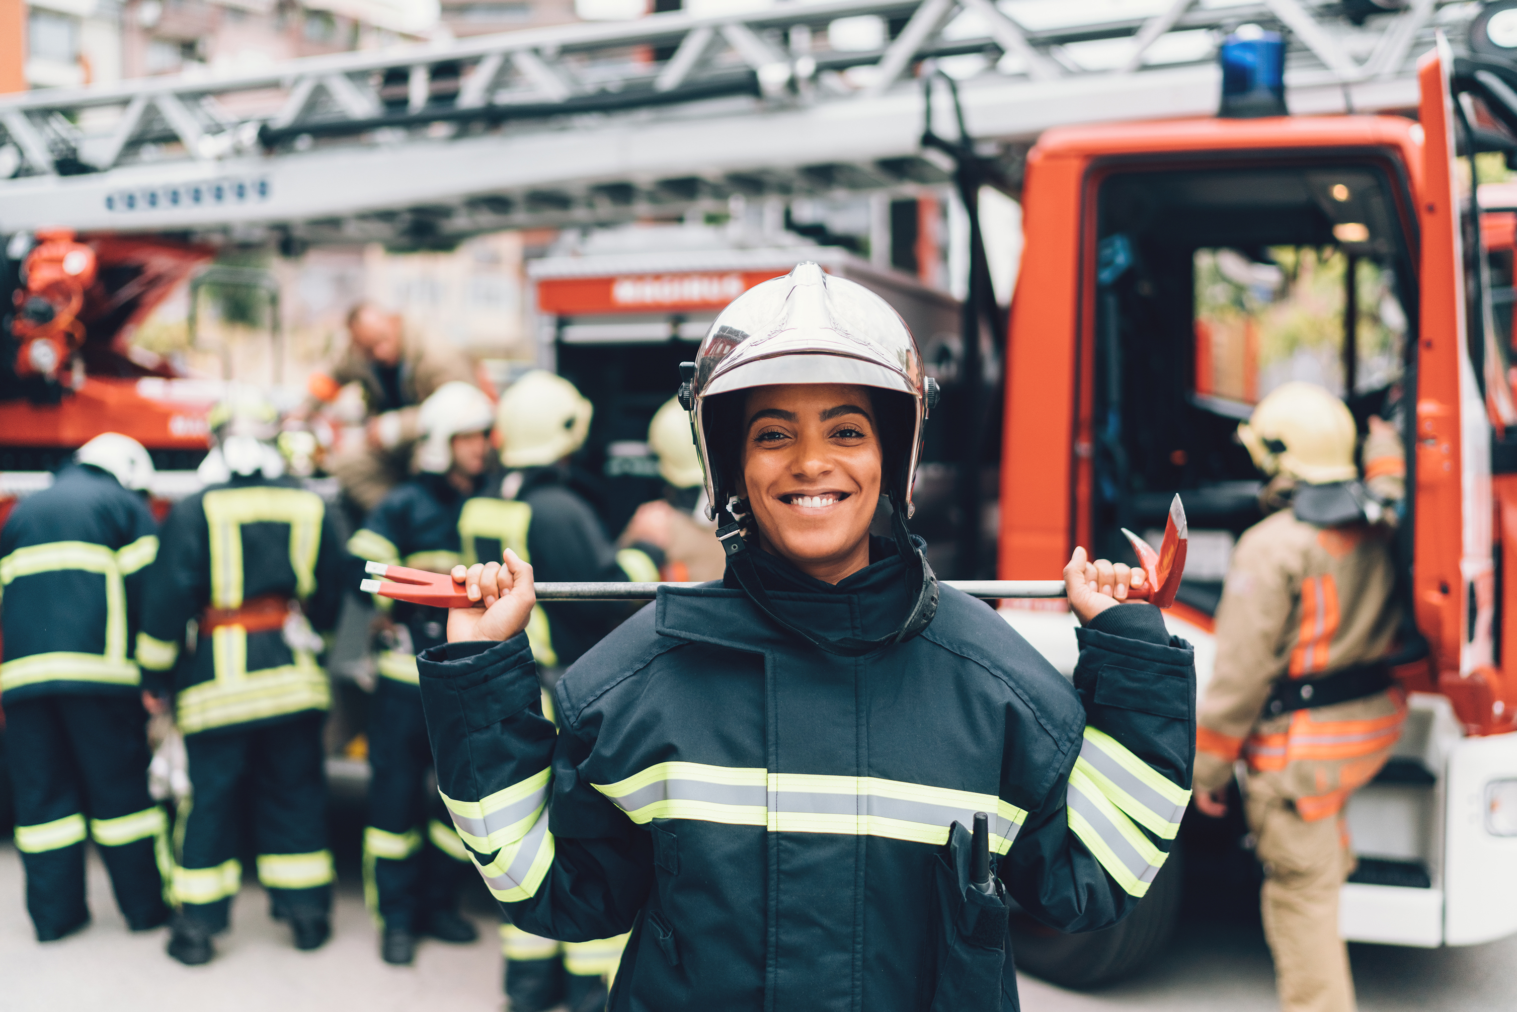
Contacting the Fire Department
Know
  How the fire department is notified
  When (eg, every fire event)
  Who is responsible for notifying
Fire Safety
Notes:
Some facilities have an internal fire brigade. These are composed of people within the building who will leave their workstations to come and assist with a fire in your unit. They may bring fire extinguishers from other areas, or they may show up to provide extra manpower and to assist with evacuation if necessary. [Note to presenter: Delete if not present in your facility]
The external fire department should be notified of every fire in the perioperative area. [Note to presenter: Insert policy for your facility] Fire department personnel can assist not only in extinguishing the fire but in evacuation if necessary. Most important, for small fires, they can assist in investigating the situation.
The facility fire plan should dictate how the fire department is notified and who is responsible for the notification. [Note to presenter: Insert the method used in your facility].
The fire department usually takes from 3 to 15 minutes to arrive [Note to presenter: Insert here the time needed to your facility].

Slide 38
The Local Authority Having Jurisdiction
May assist with perioperative education programs
Determine types of fire extinguishers
Determine dispenser location and amount of alcohol-based hand hygiene product that can be stored
Fire Safety
Notes:
The local “authority having jurisdiction” is an individual or organization designated by a state or government agency to enforce building codes or other regulations. At [facility name], the authority having jurisdiction is [the local fire marshal or other facility-specific entity].
The local fire department doesn’t just fight fires. They also assist with education on fire prevention and management and can provide advice about appropriate fire extinguisher selection and storage of flammable substances (eg, alcohol-based hand hygiene products).

Slide 39
References
Surgical Fire Prevention. ECRI. Accessed December 8, 2023. https://www.ecri.org/solutions/accident-forensic-investigation-services/surgical-fire-prevention
Surgical Fire Data. ECRI. 2009. Updated 2017.
Surgical Fires. ECRI. 2016. https://www.ecri.org/components/HRC/Pages/SafSec13_1.aspx
Wright R. Guideline for a Safe Environment of Care. Kyle E, ed. eGuidelines+ ed. Association of periOperative Registered Nurses (AORN), Inc.; 2023.
Culp Jr. WC, Kimbrough BA, Luna S. Flammability of surgical drapes and materials in varying concentrations of oxygen. Anesthesiology. 2013;119(4):770-776.
Fire Safety

